Slide 1
Big Mountain Ski Resort
Rising above the average.

Slide 2
Each year, about 350,000 skiers and snowboarders come to Big Mountain Resort in Montana. Compared to other resorts in the country, they stand in the top 10% when it comes to features such as Vertical Drop, number of runs and total skiable area. Despite being one of the country's leading resorts, Big Mountain is basing its ticket price simply on the national average.
My goal for this project was to improve value for the resort by either reducing cost, or creating a model which supports a higher ticket price.

Slide 3
Currently, Big Mountain Resort charges $81 for an Adult Lift Ticket, which falls in the top 20% of the market. Based on our models, four features were identified as being the most important when it came to creating a ticket price:
Number of fast quads
Number of runs
Snow Making
Vertical Drop
The following graphs represent where Big Mountain sits nationally, with respect to these features.

Slide 4
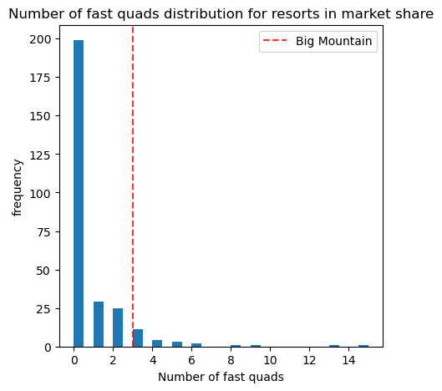
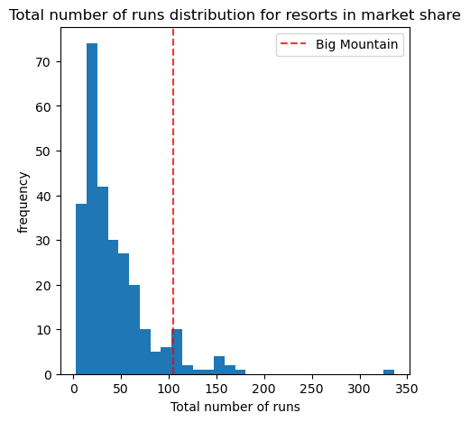
Fast Quads: 6.7%
Number of Runs: 7.7%

Slide 5
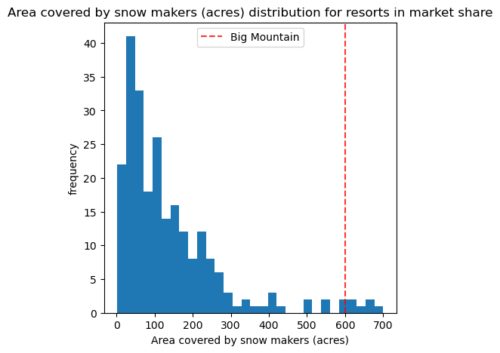
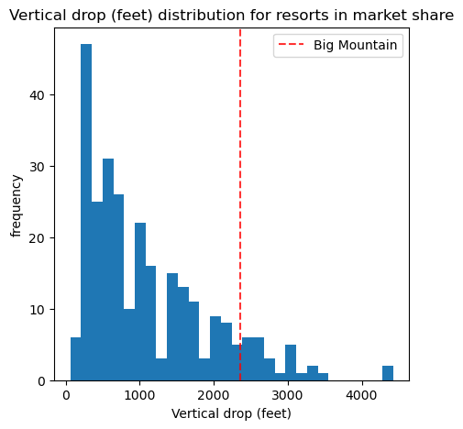
Snow Making: 3.3%
Vertical Drop: 10.5%

Slide 6
Based on these features, our model predicts an adult ticket price of $95.87, which places Big Mountain in the top 7.9% nationally, more closely aligning with it's position in the market. This increase in ticket price translates into an annual revenue increase of approx. $26,022,500.
To further increase revenue, I would recommend increasing the resort's vertical drop by 150 feet, and adding a run and an additional lift. According to the model, this change would support an additional ticket price increase of $1.99, potentially increasing annual revenue by another $3,474,638.
If Big Mountain would like to pursue closing runs to reduce cost, I would recommend starting with closing a total of three runs. The model estimates this will reduce annual revenue by approx. $1,172,500, however, without knowing the operating costs of the runs, there would be no way to say if this would be a positive change. If these closures turned out to make a positive impact, then closing two more, for a total of five closed runs maybe worth exploring. I would not recommend any more than five as the model predicts a large decrease in revenue at this point.

